Slide 1
Seat Belt Case Study
Exploring seat belt use among firefighter: A multiple case study using the Schein model of organizational culture and change. (Draft)
Burton A. Clark, Ed.D., EFO
Visiting Scholar JHU Bloomberg School of Public Health Center for Injury Research and Policy
Program Chair Management Science National Fire Academy
Reviewer NIOSH Fire Fighter Occupational Fatality Study
Sept. 8, 2013 25th Graduate Symposium
Posted on line April 2018

Slide 2
Advisors
Keshia Pollack Porter, Ph.D.
Professor
Johns Hopkins University
Bloomberg School of Pubic Health
Shannon Frattaroli, Ph.D.
Associate Professor
Johns Hopkins University
Bloomberg School of Pubic Health

Slide 3
Questons
What are the organizational culture factors that help explain lack of seatbelt use by firefighters?
How do organizational change factors help explain firefighter behavior change to using seatbelts?
Can the Schein culture & change model be used to explain fire service seatbelt doctrine?

Slide 4
11 SubjectsCases
Seatbelt stories written by 11 subjects
Fire Departments in eight states and D.C.
Subjects all NFA students
I asked them to write their stories
Cases published between 2003 - 2009

Slide 5
Seat Belt Story Story
Who
What
When
Where
Why
How
Personal, Group, Organizational

Slide 6
Seat Cases Stories
Cases
Subject | State Case # | MV LODD | 100% Pledge
Fire Chief | OH 1 | NO | Yes
Battalion Chief | NJ 2 | No | No
Assistant Chief | OH 3 | No | Yes
Deputy Chief | MA** 4 | No | No
Driver | MS 5 | Yes* | Yes
Assistant Chief | VA 6 | No | Yes
Lieutenant | TX 7 | No | Yes
West Point Cadet | DC 8 | No | No
Deputy Chief | CA 9 | Yes | NO
Battalion Chief | CT 10 | Yes | Yes
Team Brian | TX 11 | Yes | Yes
*this LODD occurred in 1972 there were no seat belts in the apparatus All FD paid personnel All had FD seatbelt SOP **state law seat belt exemption for Firefighters

Slide 7
Schein Models Model
Culture
Change
Artifacts
Espoused Beliefs
Underlying Assumptions
Un Freezing
Cognitive Restructuring
Re Freezing

Slide 8
Qualitative Method Method
I read the case
I identified the factors
I coded the factors
Manual process
No external review or evaluation

Slide 9
Culture Culture Factors (Cu) result (CU)
Artifacts
Seat Belt Policy (P)
Seat Belts in Apparatus (Sa)
Espoused Beliefs
Dressing PPE(Dp)
Donning SCBA (Ds)
Underlying Assumptions
Risk of not using seat belt normalized (R)
Fast, need to be (F)

Slide 10
Cha Change Factors (Ch) result (CH)
Unfreezing
New Disconfirming Information (Ni)
Sense of Failure (sF)
Cognitive Restructuring
Old behavior (not using seat belt)
Dissatisfying (D)
Wrong (W)
New behavior (using seat belts)
Right (R)
Do Able (Da)
Refreezing
Perform new behavior (Pb)
Get others to perform new behavior (O)
Take the seat belt pledge (TP)

Slide 11
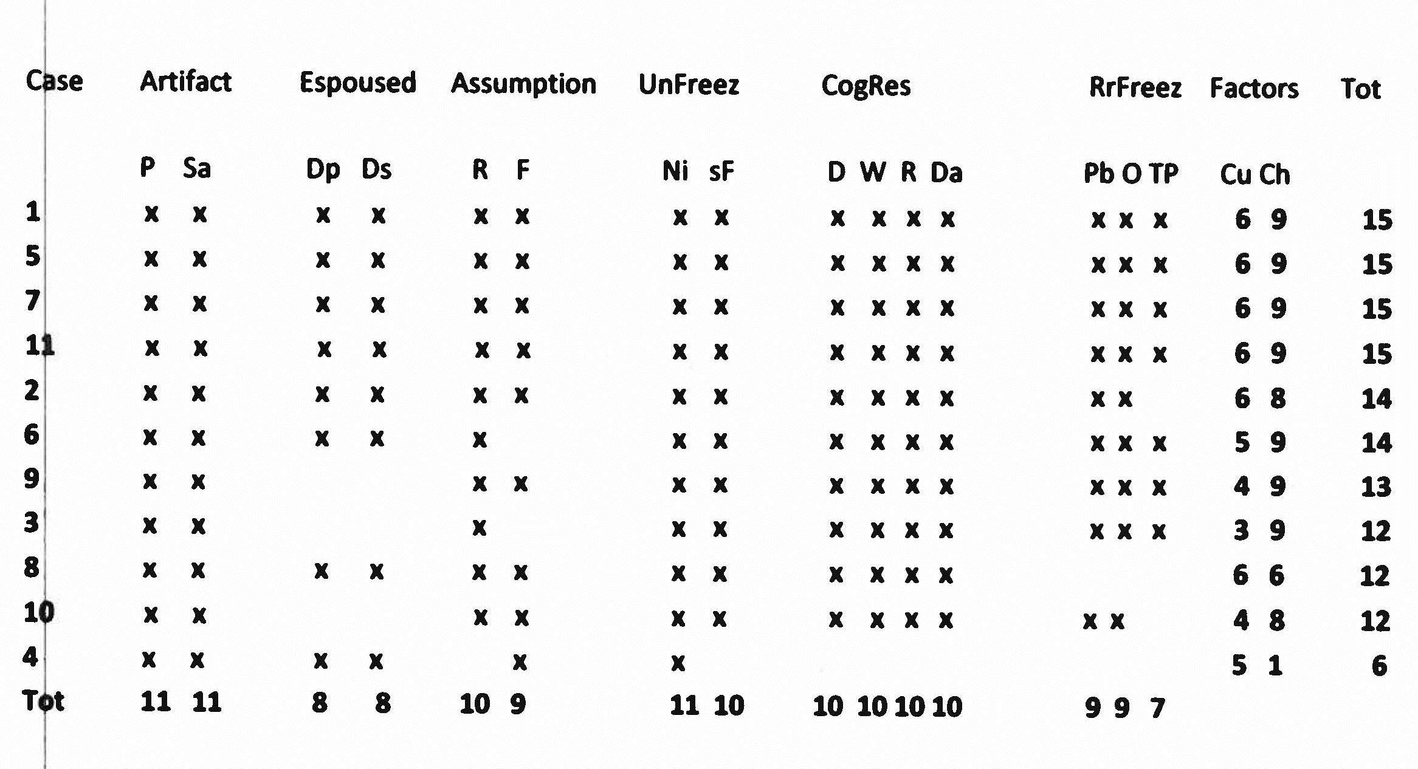
Utility of Schein model to explain firefighter Resultsseat belt doctrine

Slide 12
Limitations
No direct observational date related to the cases
Ten authors wrote from their prospective, one team
Stories not written to Schein models
Present seat belt reality in the 11 FDs is not known
All cases came from career fire departments

Slide 13
Discussion
Schein models were useful tools to help identify why firefighters did not use seat belts and the process needed to change their behavior to seat belt users in the 11 cases.
Using the models as a theory based assessment and intervention to address firefighter morbidity and mortality related to seat belt doctrine in fire departments has high potential.
Schein models may be useful tools to analyze and address other behaviors or lack of behavior that contribute to firefighter occupational injury and death.

Slide 14
Recommendations
NIOSH FF OFS may use the Schein culture model to identify artifacts, exposed beliefs, and underlying assumptions that contributed to firefighter fatalities.
NFFF my use the Schein culture model to help define the fire service culture in terms of the artifacts, espoused beliefs, and underlying assumptions that explain the disciplines safety culture or lack of a safely culture.

Slide 15
Recommendations (cont’d)
Schein’s change model my help the NFFF identify strategies to unfreeze, support cognitive restricting, and refreezing of safety behaviors incorporating leadership, management, supervision, accountability, and personal responsibility.

Slide 16
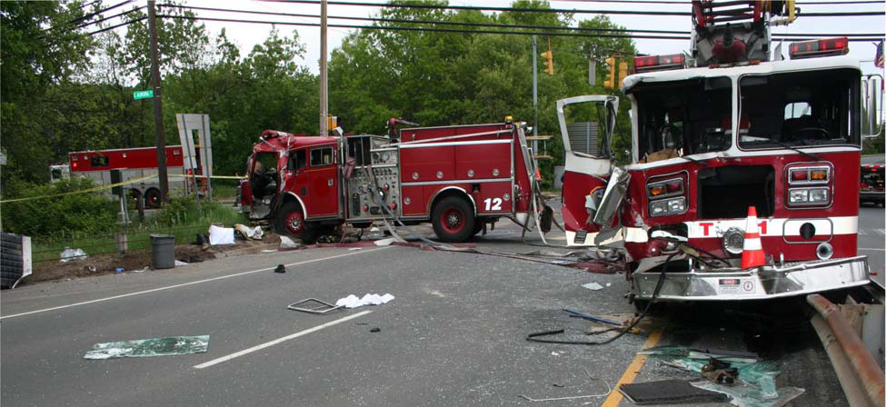
Future Future ResearchResearch
Use the Schein models to conduct an experimental
intervention in FDs to identify and change seat belt behavior.
Conduct a follow-up study of the 11 FDs to identify present seat belt behavior. (2018)

Slide 17
Additional InfoResources
US Fire Administration (2015). National Safety Culture Change Initiative. A Study of Behavioral and Motivation on Reduction of Risk – Taking Behaviors in the Fire and Emergency Service.
https://www.usfa.fema.gov/downloads/pdf/publications/fa_342.pdf
Firefighter Safety Culture web page
www.ffsafetyculture.org
Clark, B.A. (2015) I Can’t Save You, But Ill Die Trying. The American Fire Culture. Premium Press America, Nashville, TN.

Slide 18
Thant Thank You You
Burt Clark
www.AmercanFireCulture.com
drburtclark@gmail.com

